Slide 1
AVL Trees

Slide 2
Binary Search Tree
All BST operations are O(d), where d is tree depth
minimum d is for a binary tree with N nodes
What is the best case tree?
What is the worst case tree?
Best case running time of BST operations is O(log N)

Slide 3
Binary Search Tree
Worst case running time is O(N)
What happens when you Insert elements in ascending order?
Insert: 2, 4, 6, 8, 10, 12 into an empty BST
Problem: Lack of “balance”:
compare depths of left and right subtree
Unbalanced degenerate tree

Slide 4
Search Tree
4
1
2
2
5
3
1
3
4
4
2
6
5
1
3
5
7
6
7

Slide 5
Approaches to balancing trees
Don't balance
May end up with some nodes very deep
Strict balance
The tree must always be balanced perfectly
Pretty good balance
Only allow a little out of balance
Adjust on access
Self-adjusting

Slide 6
Balancing Binary Search Tree
Many algorithms exist for keeping binary search trees balanced
AVL trees (height-balanced trees)
Splay trees and other self-adjusting trees
B-trees and other multiway search trees

Slide 7
Perfect Balance
Want a complete tree after every operation
tree is full except possibly in the lower right
This is expensive
Example: insert 2 in the tree on the left and then rebuild as a complete tree
6
5
4
9
2
8
1
5
8
1
4
6
9

Slide 8
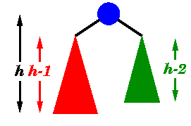
AVL Binary Tree
Named after Adelson-Velskii and Landis
The first dynamically balanced trees to be propose
Binary search tree with balance condition in which the sub-trees of each node can differ by at most 1 in their height

Slide 9
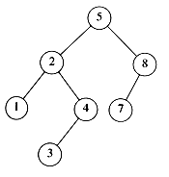
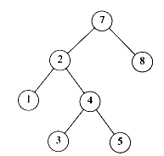
AVL tree?
YES
Each left sub-tree has height 1 greater than each right sub-tree
NO
Left sub-tree has height 3, but right sub-tree has height 1

Slide 10
AVL Tree
Height = 2 BF = 1 – 0 = 1
1
6
6
0
0
0
1
4
9
4
9
0
0
0
0
0
1
5
1
5
8

Slide 11
AVL Tree
1
2
6
6
0
1
1
2
4
9
4
9
0
0
0
0
0
1
1
5
7
1
5
8
0
7

Slide 12
AVL Tree: Single Rotation
2
0
6
1
2
6
0
0
4
9
4
8
0
0
1
0
0
0
0
1
5
8
7
9
1
5
0
7

Slide 13
Insertions in AVL Trees
Let the node that needs rebalancing be a.
There are 4 cases:
Outside Cases (require single rotation) :
1. Insertion into left subtree of left child of a.
2. Insertion into right subtree of right child of a.
Inside Cases (require double rotation) :
3. Insertion into right subtree of left child of a.
4. Insertion into left subtree of right child of a.

Slide 14
Insertions in AVL Trees
Consider a valid
AVL subtree
k
h
Z
h
h
X
Y

Slide 15
Insertions in AVL Trees: Outside Case
Do a “right rotation”
k
h
Z
h+1
h
Y
X

Slide 16
Insertions in AVL Trees Outside Case: Single right rotation
Do a “right rotation”
k
h
Z
h+1
h
Y
X

Slide 17
Single right rotation
k
“Right rotation” done!
(“Left rotation” is mirror
symmetric)
j
h+1
h
h
X
Y
Z
AVL property has been restored!

Slide 18
Insertions in AVL Trees
j
Consider a valid
AVL subtree
k
h
Z
h
h
X
Y

Slide 19
Insertions in AVL Trees: Inside Case
Inserting into Y
destroys the
AVL property
at node j
j
Does “right rotation”
restore balance?
k
h
Z
h
h+1
X
Y

Slide 20
Insertions in AVL Trees: Inside Case
k
“Right rotation”
does not restore
balance… now k is
out of balance
j
h
X
h
h+1
Z
Y

Slide 21
Insertions in AVL Trees: Inside Case
j
k
h
Z
h
h+1
X
Y

Slide 22
Insertions in AVL Trees: Inside Case
j
Y = node i and
subtrees V and W
k
h
Z
i
h
h+1
X
h or h-1
V
W

Slide 23
Insertions in AVL Trees: Inside Case
j
We will do a Left-Right
“double rotation” . . .
k
Z
i
X

Slide 24
Insertions in AVL Trees Inside Case: first rotation
j
Left rotation complete
i
Z
k
W
V
X

Slide 25
Insertions in AVL Trees Inside Case: second rotation
j
Now do a Right rotation
i
Z
k
W
V

Slide 26
Insertions in AVL Trees Inside Case: second rotation
Right rotation complete
Balance has been
restored
i
k
j
h
h
h or h-1
V
X
W
Z

Slide 27
Example

Slide 28

Example
Inserting 3, 2, 1, and then 4 and 5 sequentially into empty AVL tree
2
-1
3
0
2
1
2
0
-1
2
0
0
1
3
0
0
1
3
1
4
-2
1
2
0
-2
2
0
0
1
3
-1
1
4
0
0
4
0
5
3
5

Slide 29
Example
Inserting 6
-2
1
2
2
0
-1
0
0
1
4
1
4
0
-1
0
0
3
5
0
3
5
6
0
4
0
-1
2
5
0
0
0
1
3
6

Slide 30
Example
Inserting 7
-1
0
4
0
-2
4
0
0
2
5
0
0
-1
2
6
0
0
0
0
1
3
6
0
1
3
5
7
7

Slide 31
Example
Inserting 16 and 15
-2
-1
4
0
-2
4
0
-1
2
6
2
6
0
0
0
-2
0
0
0
-1
5
7
1
3
-1
1
3
5
7
0
16
16
0
0
4
15
0
-1
2
6
0
0
0
-1
1
3
5
15
0
0
7
16

Slide 32
Example
Inserting 14
-2
-2
4
4
0
-2
0
-2
2
6
2
6
0
0
0
-1
0
0
0
1
7
1
3
5
5
15
0
-1
1
3
0
-1
15
14
7
16
0
-1
0
16
4
14
0
0
2
7
0
0
1
0
1
3
6
15
0
0
0
16
5
14

Slide 33
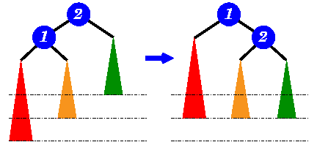
Insertions in AVL Trees Single Rotation
left sub-tree is two level
deeper than the right sub-tree
move ① up a level and
② down a level

Slide 34
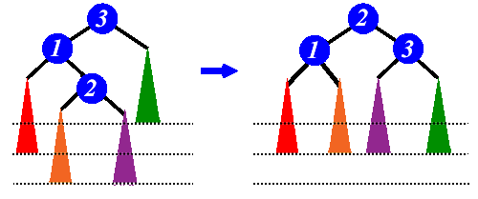
Insertions in AVL Trees Double Rotation
Left sub-tree is two level
deeper than the right subtree
Move ② up two levels and
③ down a level

Slide 35
Insertions in AVL Trees Animation
https://www.cs.usfca.edu/~galles/visualization/AVLtree.html

